Slide 1

Export Controls
Update
Laura Langton, PhD
Export Control Manager
langton@wustl.edu
314-747-1378

Slide 2
What is an Export?
“Release” of
    Tangible items e.g. equipment
    Technology
    Software
    Source code
    Technical data or information
    Defense articles or services
    ………to a foreign country or to a foreign person in the U.S. (“deemed export”).

Slide 3
  Export can occur through
    Physical transfer
    Visual inspection
    Verbal discussions
    Email/Fax
    Computer data disclosure
    Training
Depending on the specific technologies and countries involved, a government license may be needed.

Slide 4



Export Control Regulations
Department of State
International Traffic in Arms Regulations
(ITAR) Directorate of Defense Trade Controls
Military Technologies
22 CFR 120 -130
Department of Commerce
Export Administration Regulations (EAR)
Bureau of Industry and Security
Dual-Use Technologies (civilian or military,
space, satellite)
15 CFR 730-773
  U.S. Sanctions and Embargoed Regimes. Lists of “Specially Designated Nationals (SDNs)”31 CFR 500-598
  Country Policies and Embargoes
Department of the Treasury
Office of Foreign Assets Control (OFAC)

Slide 5
  Areas of Low Risk
  Most equipment on campus not highly restricted (EAR99)
    Notable exceptions – high tech cameras, optics, night vision
  Most labs doing Fundamental Research
  “Fundamental Research” Exclusion (FRE)
  basic and applied research in science and engineering
  no publication restrictions; no participation restrictions
  not proprietary
  Information resulting from Fundamental Research is exempt from export controls.

Slide 6
  Areas of High Risk
  FRE does NOT protect us when
  Technology falls under the ITAR (USML)
  Shipping or carrying technology overseas
  Export controlled proprietary information is involved
  New Threats to Fundamental Research
  Revised ITAR categories with catch all phrases e.g.
    “developmental electronics funded by DoD”
  New clauses in Defense contracts e.g. DFARS 252.204-7012

Slide 7
But I’m just doing research….What could go wrong?
PENALTIES
 | EAR | ITAR | OFAC
CIVIL | Up to $120,000 per violation | Up to $500,000 per violation | Up to $55,000 per violation
CRIMINAL | Up to $1 million and/or up to 10 years in prison | Up to $1 million and/or up to 10 years in prison | Up to $1 million per violation and/or up to 10 years in prison
Seizure and forfeiture of items
Loss of export privileges
Loss of federal funding
Harm to reputation
Disruption of research!!

Slide 8
Buying Equipment – Red Flags
First Red Flag
Vendor site looks like this….

Slide 9
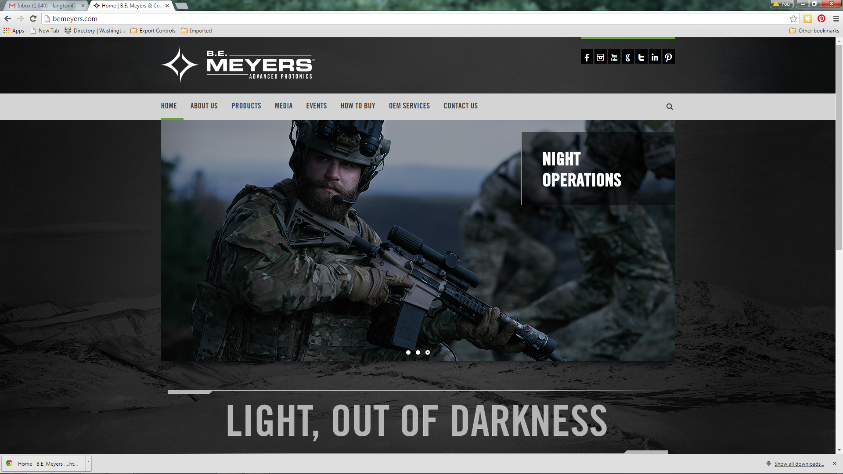

Slide 10
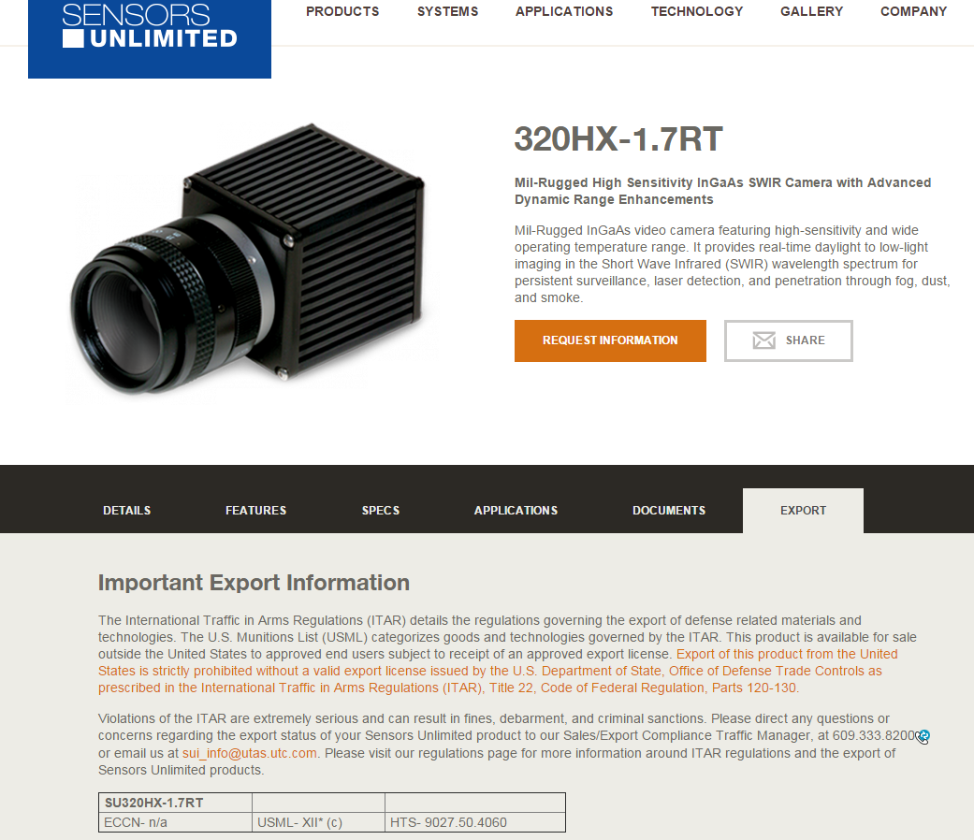
Red Flag

Slide 11
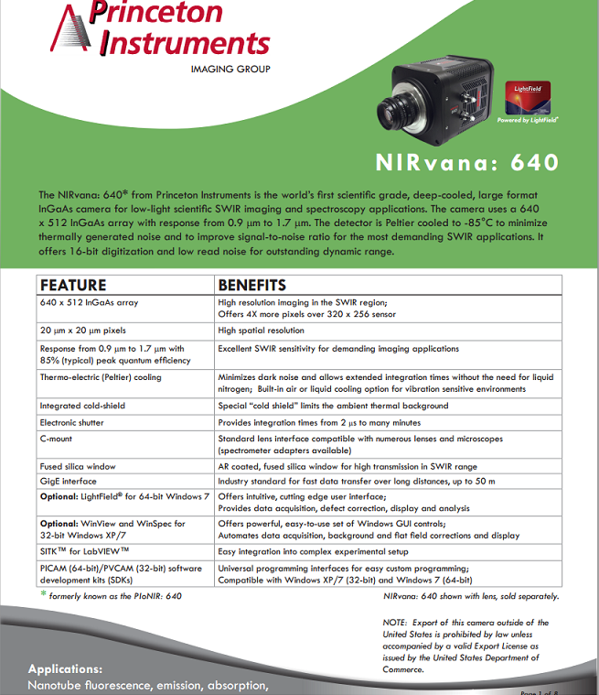
Red Flag
References to Export, ITAR or EAR.

Slide 12
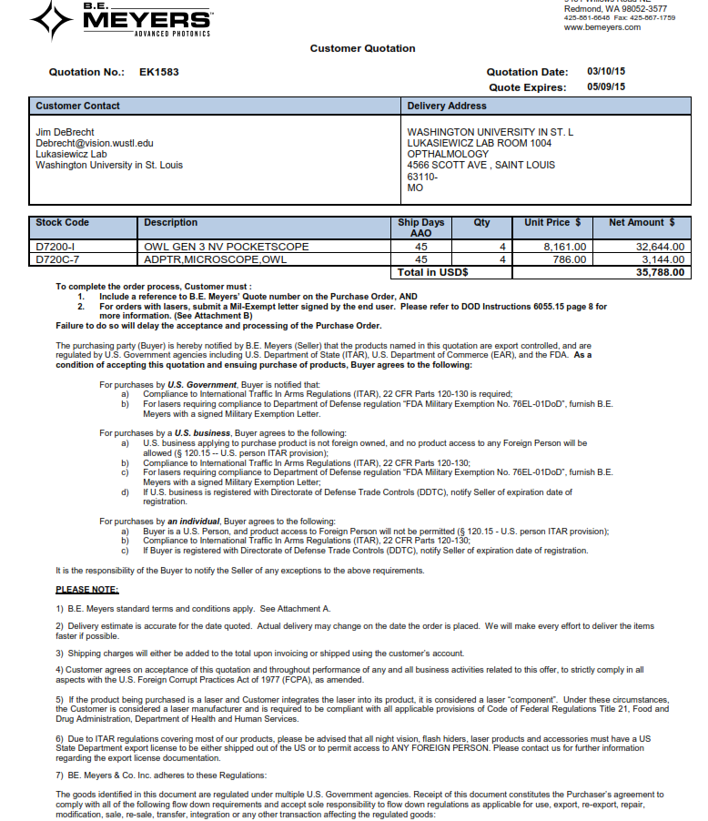
Red Flag
Buyer agrees to the following:
a) U.S. business applying to purchase product is not foreign owned, and no product access to any Foreign Person will be
allowed (§ 120.15 -- U.S. person ITAR provision);
b) Compliance to International Traffic In Arms Regulations (ITAR), 22 CFR Parts 120-130;
Due to ITAR regulations covering most of our products, please be advised that all night vision, flash hiders, laser products and accessories must have a US
State Department export license to be either shipped out of the US or to permit access to ANY FOREIGN PERSON.

Slide 13
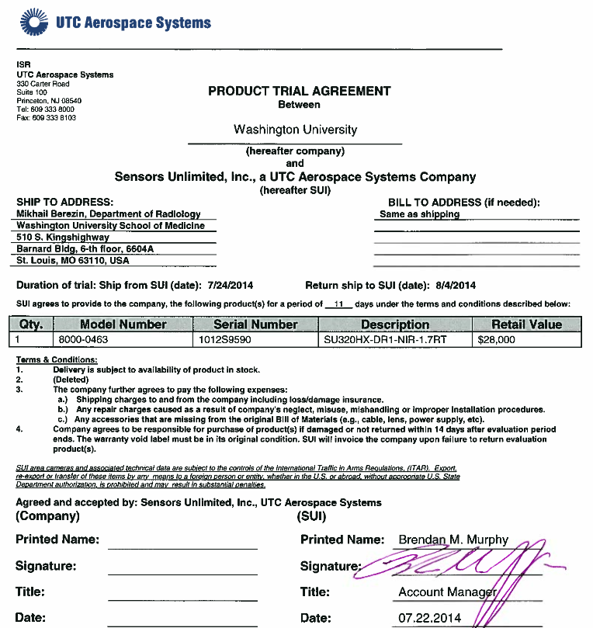
Red Flag
SUI area cameras and associated technical data are subject to the controls of the International Traffic in Arms Regulations (ITAR).

Slide 14
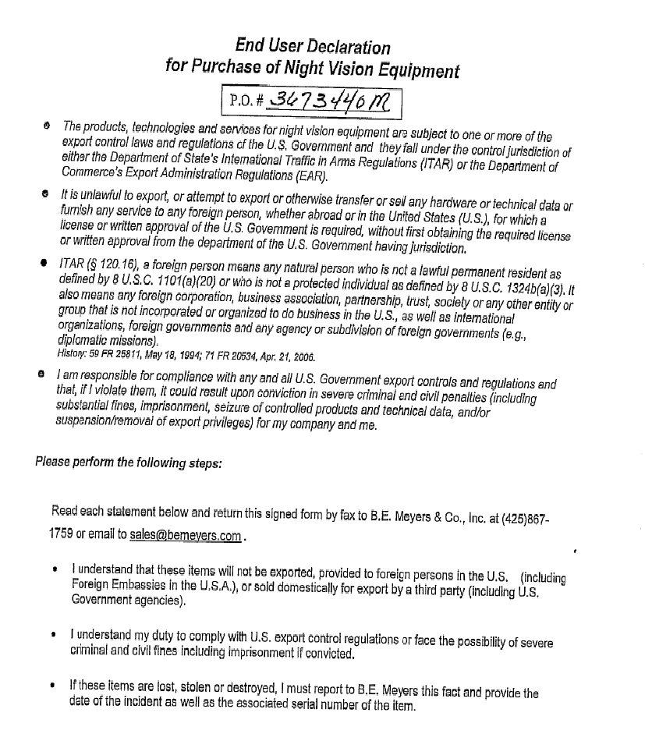
Red Flag
I understand that these items will not be exported, provided to foreign persons in the U.S.

Slide 15
Overseas Travel
Export Control
Contact the Export Control Manager for
Restricted Party Screening (RPS) of institutions you plan to visit
License requirements for any technology you are taking with you
Travel Resources
Washington University now offers
Clean laptops for temporary use.
  contact the Solutions Center at 314-935-8200 or email solutionscenter@wustl.edu.
Short term international healthcare plan
Emergency Assistance Services
International Travel Registry
For more information on these topics go to the Washington University in St. Louis Global Engagement website
https://global.wustl.edu/international-policies-resources/

Slide 16
For more information or for consultation on a specific project, please contact:
Laura Langton, PhD
Export Control Manager
747-1378 langton@wustl.edu

