Slide 1

Export Control
Laura Langton, PhD
Export Control Manager
langton@wustl.edu
314-747-1378

Slide 2
What is an Export?
“Release” of
    Tangible items e.g. equipment
    Technology
    Software
    Source code
    Technical data or information
    Defense articles or services
    ………to a foreign country or to a foreign person in the U.S. (“deemed export”).

Slide 3
What are Export Controls?
Federal regulations over the “export” of technology and technical information to foreign countries.
Why should I care?
Export controls can affect university activities including:
  Research, equipment access by foreign nationals on campus
  Hosting foreign visitors
  Travel overseas
  International shipping
  Overseas collaborations

Slide 4
  Four Elements of U.S. Export Controls
Technology Classification
What is being exported?
Item, software, technical data?
Military or dual-use? Classification?
Where is it going?
Sanctioned or embargoed country?
Destination
Who will receive it?
Restricted party? Military end user? WMD proliferator?
End-User
What will they do with it?
Prohibited end-uses e.g. biological, chemical, nuclear weapon proliferation
  End-Use

Slide 5
Export Control Regulations
ITAR
Military use technology
Technology Classification
EAR
Dual use technology
Destination
OFAC
Country sanctions and embargoes
End-User
End-Use
Restricted Party Lists
(multiple agencies)

Slide 6
But I’m just doing research….What could go wrong?
PENALTIES
 | EAR | ITAR | OFAC
CIVIL | Up to $120,000 per violation | Up to $500,000 per violation | Up to $55,000 per violation
CRIMINAL | Up to $1 million and/or up to 10 years in prison | Up to $1 million and/or up to 10 years in prison | Up to $1 million per violation and/or up to 10 years in prison
Seizure and forfeiture of items
Loss of export privileges
Loss of federal funding
Harm to reputation
Disruption of research!!

Slide 7
How can I comply with these regulations?
Best Practices
CALL THE EXPORT CONTROL MANAGER WHEN:
Grants or contracts contain sponsor restrictions on publication or participation.
Shipping or carrying technology overseas.
Hosting foreign visitors other than students, postdocs, H-1Bs.
Interacting with and travel to sanctioned countries (e.g. Iran, Cuba, Syria, Sudan, North Korea).
When purchasing export controlled equipment.

Slide 8
How do I know which equipment is export controlled?
Equipment Red Flags
Technology that
  was designed for military use
  is being developed for military use
  has export warnings – words like “export” “ITAR” “EAR”
    FOREIGN NATIONALS MUST HAVE A LICENSE TO ACCESS ITAR CONTROLLED TECHNOLOGIES (consult the Export Control Manager).

Slide 9
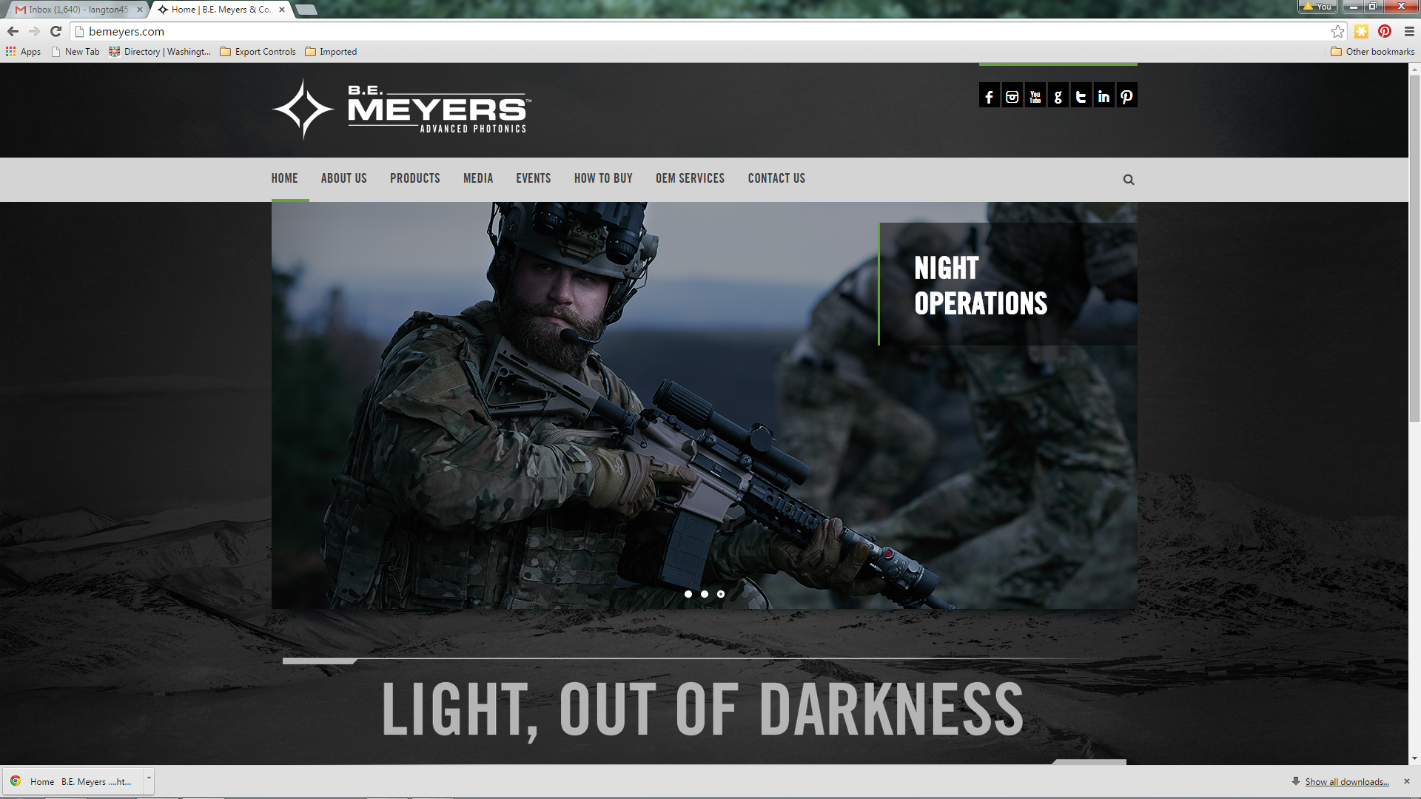
Red Flag – when a vendor site looks like this…..

Slide 10
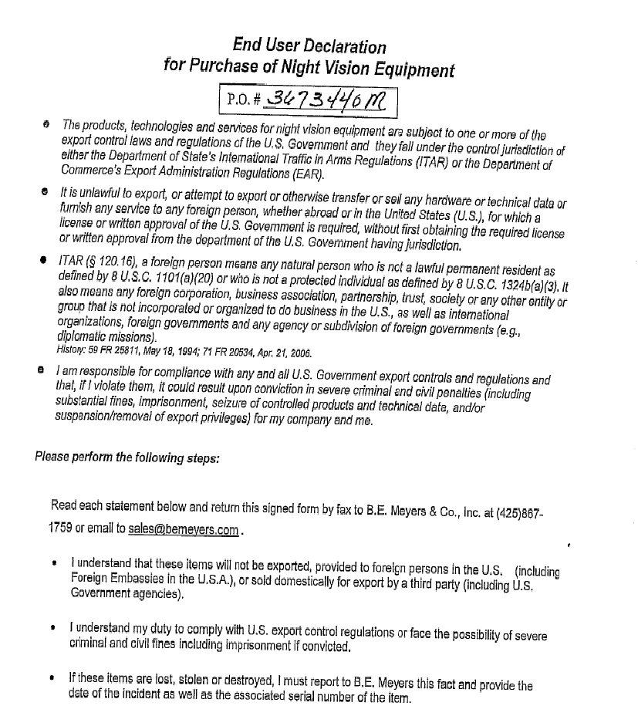
Red Flag
I understand that these items will not be exported, provided to foreign persons in the U.S.

Slide 11
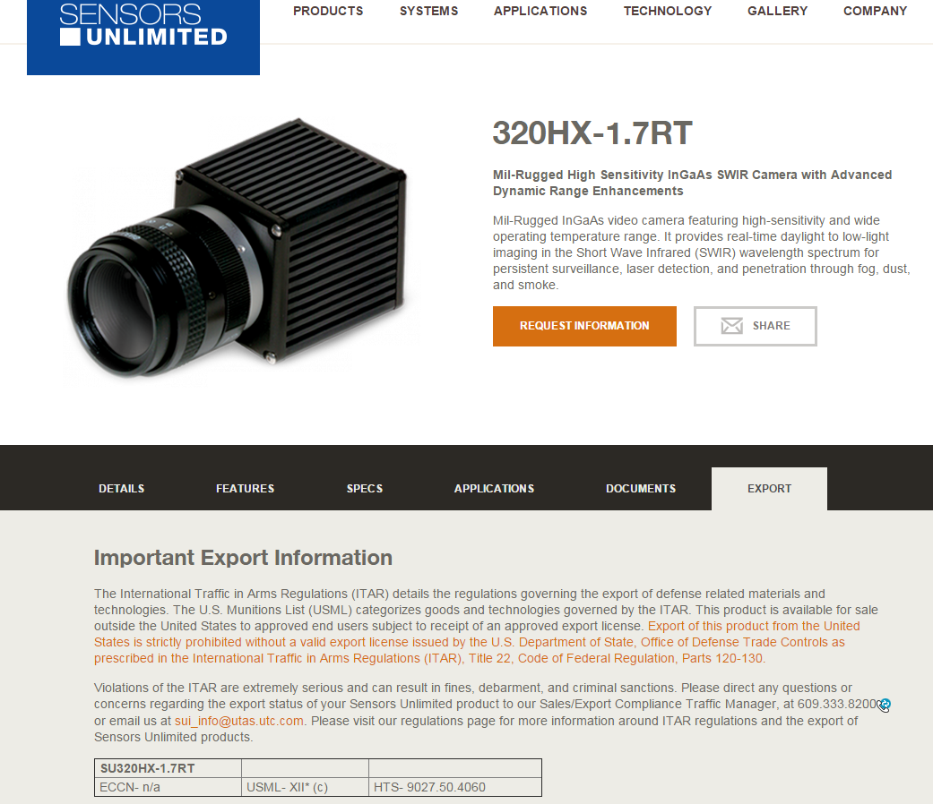
Red Flag

Slide 12
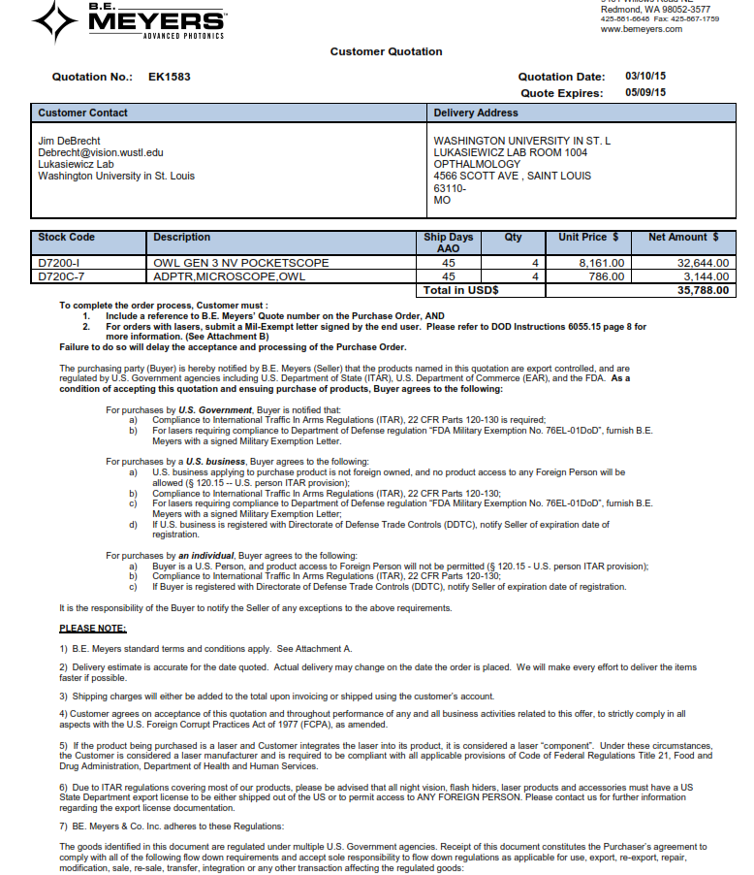
Red Flag
Buyer agrees to the following:
a) U.S. business applying to purchase product is not foreign owned, and no product access to any Foreign Person will be
allowed (§ 120.15 -- U.S. person ITAR provision);
b) Compliance to International Traffic In Arms Regulations (ITAR), 22 CFR Parts 120-130;
Due to ITAR regulations covering most of our products, please be advised that all night vision, flash hiders, laser products and accessories must have a US
State Department export license to be either shipped out of the US or to permit access to ANY FOREIGN PERSON.

Slide 13
Best Practice - Buying Equipment
  When buying items over $5,000 (excepting computers), obtain the export control classification from the vendor
  Examples of items often export controlled
  Cameras (specialty – high speed, infrared, underwater), night vision, lasers, drones. Equipment specifically designed for clinical use is low risk.
  Examples of export control classifications
  Code of letters and numbers such as “6A997” (ECCN)
  Category with Roman numerals e.g. “ITAR Category XII”
  If anything other than “EAR99”, call the Export Control Manager (ECM)
  How do I find out the classification of an item?
  Check the website and product or purchase documentation
  Contact the vendor
  If no luck call the ECM for assistance.

Slide 14
Best Practices – Overseas Travel
Contact the Export Control Manager for :
  Restricted Party Screening (RPS) of institutions you plan to visit.
  License requirements for technology that you are taking with you.
Take a CLEAN laptop – assume nothing is secure. Also, high level encryption is not allowed in some countries (mass market ok).
  contact the Solutions Center at 314-935-8200 or email solutionscenter@wustl.edu.

Slide 15
Overseas Travel
Travel Resources
Washington University now offers
Short term international healthcare plan
Emergency Assistance Services
International Travel Registry
For more information on these topics go to the Washington University in St. Louis Global Engagement website
https://global.wustl.edu/international-policies-resources/

Slide 16
For more information or for consultation on a specific project, please contact:
Laura Langton, PhD
Export Control Manager
747-1378 langton@wustl.edu

