Slide 1
Congressionally directed medical research program
Mission: “Responsibly manage collaborative research that discovers, develops and delivers health care solutions for Service Members, veterans, and the American public.”
Started in 1992 to support breast cancer research – has since supported research in more than 50 topic areas
Created as way for Congress to assert influence over biomedical research agenda
CDMRP funds added annually by appropriators – not part of President’s Budget Request or NDAA
Congress dictates topics, but open competitions/peer review employed in funding decisions

Slide 2
Notes:
All relevant to the DOD mission

Slide 3
An interesting year for CDMRP…
Under the FY 2025 CR, CDMRP received a significant cut (57%) from $1.5 billion in FY 2024 to $650 million
Due to the significant funding reduction, CDMRP was directed by Congress to only run 12 of its 35 programs for FY 2025
More information here: https://cdmrp.health.mil/pubs/press/2025/FY25_Appropriations.aspx
The CDMRP topics were dictated by the FY 2025 Continuing Resolution passed in March
CDMRP is currently releasing pre-announcements – preview types of awards and funding size
Magic date: April 28 – expect to see funding opportunities after this date!
Likely to be even more competitive process this year
Less funding across programs
More applications given disruptions at HHS
Highly competitive: Success rates average around 15% (range of 10-30 percent)
Notes:
April 28 – deadline for DOD spend plan

Slide 4
CDMRP 2025 Topics
Peer-Review Medical ($150m)
Traumatic Brain Injury and Psychological Health
Breast Cancer ($130m)
Peer-Review Cancer ($130m)
Prostate Cancer ($75m)
Kidney Cancer
Ovarian Cancer ($15m)
Amyotrophic Lateral Sclerosis ($40m)
Melanoma ($40m)
Spinal Cord
Toxic Exposures ($15m)
Peer-Review Orthopedic
Lung Cancer
Neurofibromatosis
Joint Warfighter Medical
Vision
Multiple Sclerosis
Rare Cancers Research ($17.5m)
Parkinson’s
Pancreatic Cancer
Alzheimer’s Disease ($15m)
Autism
Epilepsy
Reconstructive Transplant
Arthritis
Glioblastoma
Lupus
Duchenne Muscular Dystrophy ($12.5m)
Military Burn ($10m)
Tuberous Sclerosis
Bone Marrow Failure
Tickborne Disease
Hearing Restoration
Combat Readiness Medical
Alcohol and Substance Use Disorders
Note: Bolded programs running in FY 2025
Notes:
How did CDMRP choose topics this year? These were in the CR

Slide 5
Peer Reviewed Medical Research Program FY 2025 Topics
Accelerated Aging Processes
Celiac Disease
Computational Biology for Precision Health
Congenital Cytomegalovirus
Congenital Heart Disease
Dystonia
Eating Disorders
Ehlers-Danlos Syndrome
Epidermolysis Bullosa
Far-UVC Germicidal Light
Fibrous Dysplasia/McCune-Albright Syndrome
Focal Segmental Glomerulosclerosis
Food Allergies
Fragile X
Frontotemporal Degeneration
Guillain-Barre Syndrome
Hemorrhage Control
Hepatitis B
Hereditary Ataxia
Hydrocephalus
Inflammatory Bowel Diseases
Interstitial Cystitis
Lymphedema
Malaria
Maternal Mental Health
Mitochondrial Disease
Musculoskeletal Disorders Related to Acute and Chronic Bone Conditions and Injuries
Myalgic Encephalomyelitis/Chronic Fatigue Syndrome
Myotonic Dystrophy
Nephrotic Syndrome
Neuroactive Steroids
Pancreatitis
Peripheral Neuropathy
Polycystic Kidney Disease
Proteomics
Pulmonary Fibrosis
Respiratory Health
Scleroderma
Sickle-Cell Disease
Suicide Prevention
Vascular Malformations
*Additionally, any topics included in the FY 2025 Senate defense appropriations report.
Total = 56 topics!

Slide 6
Peer Reviewed Cancer research Program FY 2025 Topics
Bladder cancer
Blood cancers
Brain cancer (excluding glioblastoma)
Colorectal cancer
Endometrial cancer
Esophageal cancer
Germ cell cancer
Head and neck cancer
Liver cancer
Lymphoma
Mesothelioma
Metastatic cancers
Myeloma
Neuroblastoma
Pediatric brain tumors
Pediatric, adolescent, and young adult cancers
Sarcoma
Stomach cancer
Thyroid cancer
*Additionally, any topics included in the FY 2025 Senate defense appropriations report.

Slide 7
CDMRP Proposal process
Proposal windows vary throughout the year, many applications open in the spring
Pre-application required
Various research awards at all career stages:

Slide 8
CDMRP Review process
Two-tier review process: peer review for scientific merit and programmatic review to ensure the DOD mission and needs are met

Slide 9
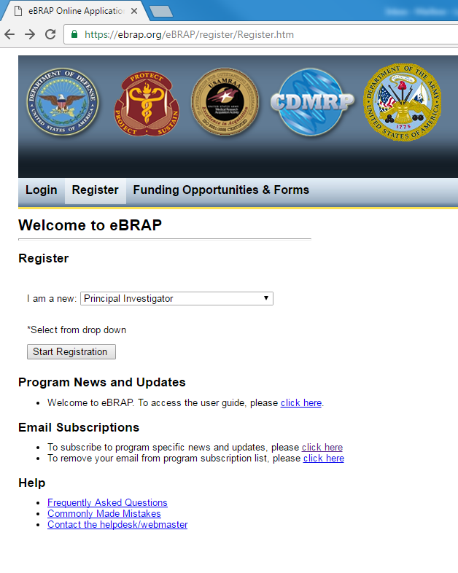
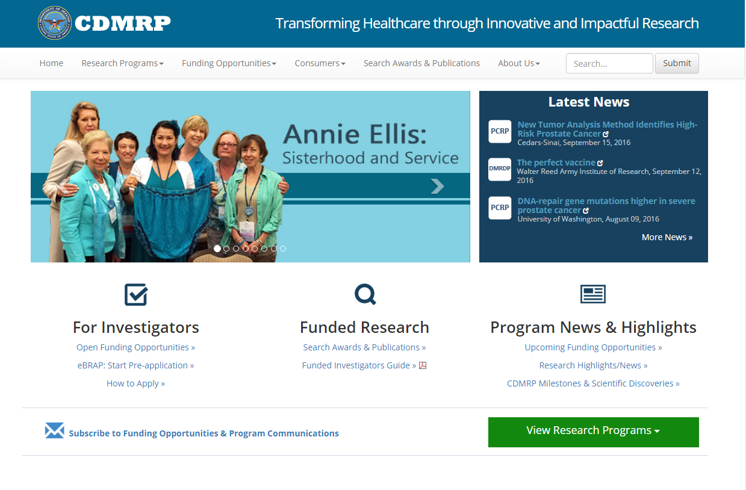
CDMRP Resources
Additional Funding Opportunity Postings:
www.grants.gov
https://sam.gov/content/home
www.eBRAP.org

Slide 10
Tips for engaging with cdmrp
Military Health System Research Symposium
Annual conference held every summer/fall (August 4-7, 2025) in Florida is DOD’s premier medical research meeting
Unique opportunity to engage with program managers and DOD officials from CDMRP, other military health programs, and public/private sector partners
Lewis-Burke will host a webinar with CDMRP this Spring on best practices to engage
CDMRP is planning to host multiple webinars on the released funding opportunities, similar to last year

Slide 11
Congressionally Directed Medical Research Program (CDMRP) Funding Webinar
April 14, 2025
Research Development Office
Office of the Vice Chancellor for Research

Slide 12
Welcome & Introductions
Summer Young, Senior Associate Director, WashU Research Development Office
Amber Cassady, Principal, Lewis-Burke Associates
Panelists
Bettina Drake, Professor of Surgery, Division of Public Health Sciences, School of Medicine
Matthew Wood, Associate Professor of Surgery, Division of Plastic and Reconstructive Surgery, School of Medicine
Notes:
INTRODUCTIONS
-RDO, myself, colleagues
-Amber Cassady, Lewis-Burke Associates, a DC government relations firm focused on research and academia that is providing consultation services to WashU faculty and leadership to advance our research portfolio with mission-based federal agencies.
-DISTINGUISHED PANELISTS, who have been both funded by and served as reviewers for CDMRP:
--Bettina Drake, Professor of Surgery, Division of Public Health Sciences
--Matthew Wood, Associate Professor of Surgery, Division of Plastic and Reconstructive Surgery

Slide 13
Agenda
Welcome
Overview of Congressionally Directed Medical Research Program
RDO Resources for CDMRP Proposal Development
CDMRP-Funded Investigator & Reviewer Panel with Q&A
Notes:
HOUSEKEEPING
*RDO will be making slides and webinar recording available to attendees behind firewall requiring WUSTL Key login
*Place questions in chat
*Introduce Amber Cassady

Slide 15
Common CDMRP Full Proposal Components
Project Narrative
Background
Hypothesis/Objective
Specific Aims
Research Strategy and Feasibility
Supporting Documentation
References Cited
List of Abbreviations, Acronyms & Symbols
Facilities, Existing Equipment, & Other Resources
Publications &/or Patents
Letters of Organizational Support
Letters of Collaboration
Intellectual Property
Data & Research Resources Sharing Plan
Use of DOD Resources
Use of VA Resources
Quad Chart
Technical Abstract
Lay Abstract
Statement of Work
Human Subject Recruitment & Safety Procedures
Data Management
Impact Statement
Relevance to Military Health Statement
Transition Plan and Regulatory Strategy
Representations
Suggested Collaborating DOD Military Facility Budget Format
R&R Personal Data
R&R Senior/Key Person Profile (Expanded) – PI and S/KP
Biographical Sketch
Previous/Current Pending Support – must use DOD format
R&R Budget
Budget Justification
Project/Performance Site Location(s) Form
R&R Subaward Budget Attachment for PER SUB
Subaward Budget Justification PER SUB
Notes:
SOW
-outline of Specific Aims that establishes project milestones during award performance period
-should contain sufficient detail to be informative as a STAND ALONE document
-no limit objectives, tasks, subtasks
-template provided

Slide 16
Application Logistics Unique to CDMRP
Pre-applications must be submitted through Electronic Biomedical Research Application Portal (eBRAP)
Invited full applications submitted via Grants.gov (must include assigned eBRAP log number)

Slide 17
Research Development Office
Research Development bridges disciplines, schools, and campuses to support the pursuit of research funding, the development of cross-disciplinary research center proposals, and the initiation of cross-school teams and external research partnerships.
Alert faculty to new funding opportunities
Manage the Institutional internal selections process
Provide guidance and tools for development of cross-disciplinary research centers
Host informational events and resources for grant writing
Oversee OVCR seed funding and Here and Next Seed Funding Programs
Facilitate cross-disciplinary team science
researchdevelopment@wustl.edu

Slide 18
RDO Support Examples
Help identifying agency priorities, exploring your work’s potential relevance, and communicating its value
Team building & ideation
Proposal development support
Project management support of the proposal development process
Red Team review & coordination
Technical editing
DOD-specific support
DOD Funding Virtual Office Hours: 12-1pm, 4th Wednesday monthly
DOD funding agencies information on website: https://research.washu.edu/funding/federal-funding/
Links to prior webinars: https://research.washu.edu/offices/research-development/federal-agency-information/#FA

Slide 19
CDMRP Funding Panel
Bettina Drake
Professor of Surgery, Division of Public Health Sciences, School of Medicine
Matthew Wood
Associate Professor of Surgery, Division of Plastic and Reconstructive Surgery, School of Medicine
Notes:
Panelists’ background &experience working on CDMRP projects/reviewing 11:20-11:40am
Q&A (Summer Young, RDO moderating) 11:40am-11:55am

Slide 20
Q&A
Notes:
SUMMER MODERATING

Slide 21
Research Development Office
https://research.washu.edu/offices/research-development/
researchdevelopment@wustl.edu

